Slide 1


Slide 2
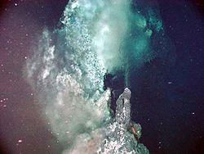

Mining of HYDROTHERMAL DEPOSITS

Slide 3
AN INTRODUCTION

Slide 4
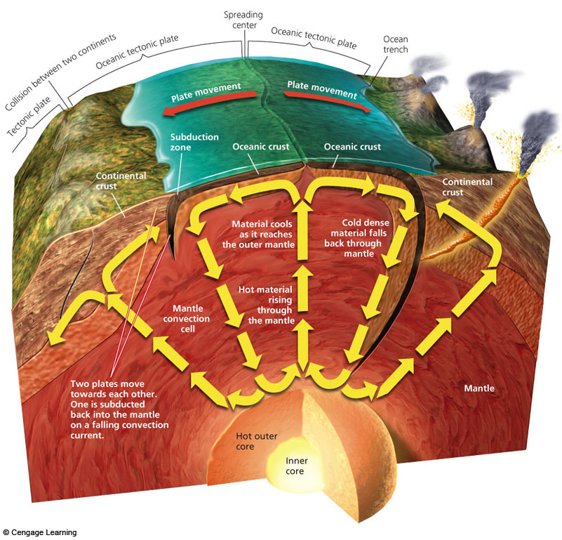
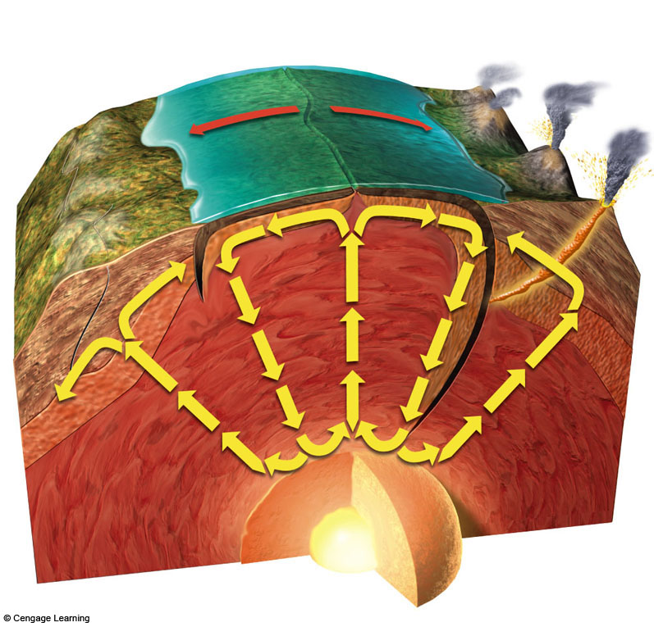
An Insight into the CORE and ROCK CYCLE: A proof of Dynamic Core

Slide 5
OCEANS & SEAS : Abundant sources
Minerals from seawater
Minerals from ocean sediments
Hydrothermal deposits
Manganese-rich nodules

Slide 6
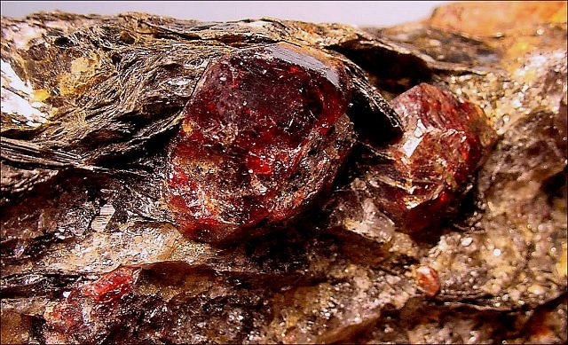
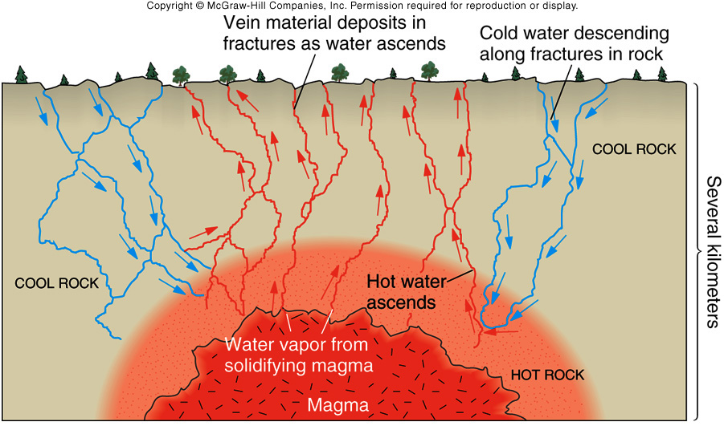
Metamorphic and Hydrothermal Rocks

Slide 7
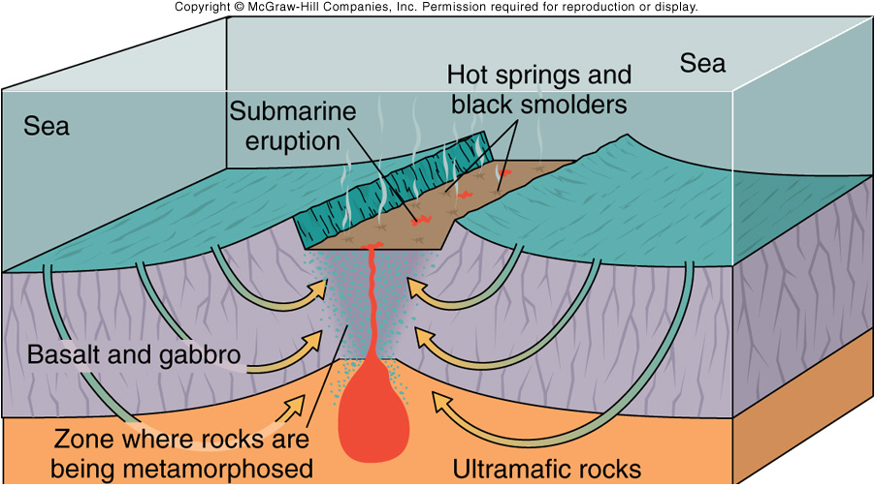
Plate tectonics & Metamorphism in the HYDROTHERMAL PROCESS
Hydrothermal Activity at Divergent Plate Boundaries
Metasomatism
Hydrothermal Rocks and Minerals
Sources of Water

Slide 8
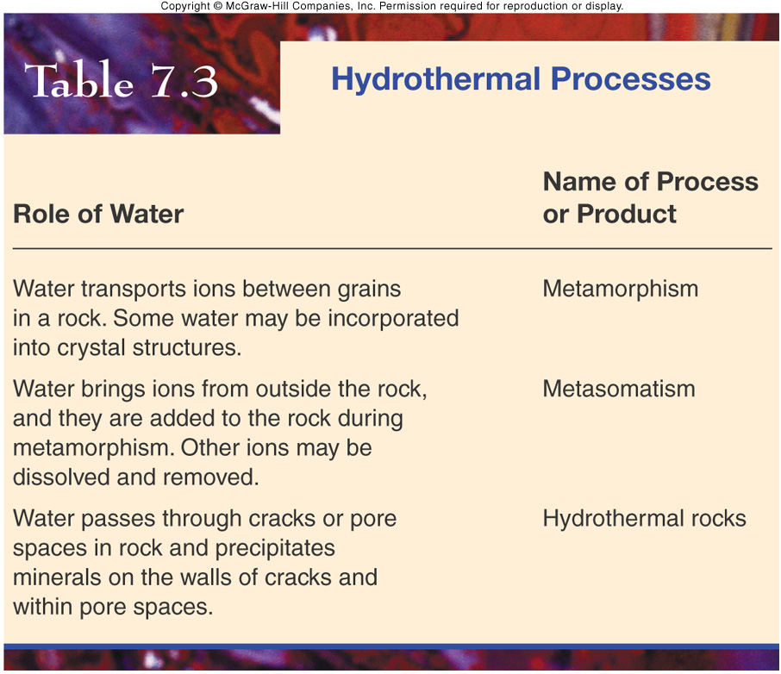
HYDROTHERMAL Process

Slide 9
ORE BODIES CONFIRMABLE TO HYDROTHERMAL MINING

Slide 10
Hydrothermal Ore Bodies
600 C: Tungsten , Tin in Granites
400 C: Gold, Uranium , Silver , Cobalt , Molybdenum, Copper
  Gold-Quartz deposits
  Porphyry Copper
  Marginal ores around intrusions
200 C: Copper, Zinc, Cadmium, lead
  Outer contact zones
  Mississippi Valley ore deposits
Cool: Mercury, Arsenic
  Hot springs, fault zones

Slide 11
HYDROTHERMAL ORE DEPOSITS
DEPTH-TEMPERATURE CLASSIFICATION
I) Epithermal deposits
shallow depth of formation and moderate temperature
II) Meso-thermal deposits
moderate depth of formation and temperature
III) Hypothermal deposits
great depth of formation and temperature
IV) High level, high temperature intrusion-related deposits
porphyry and skarn deposits

Slide 12
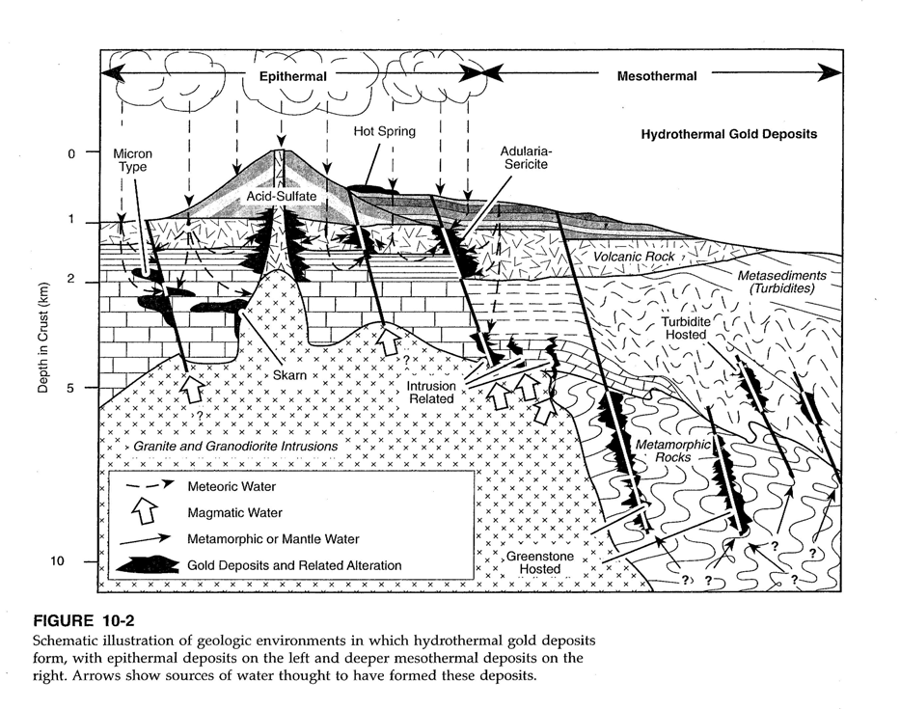

Slide 13
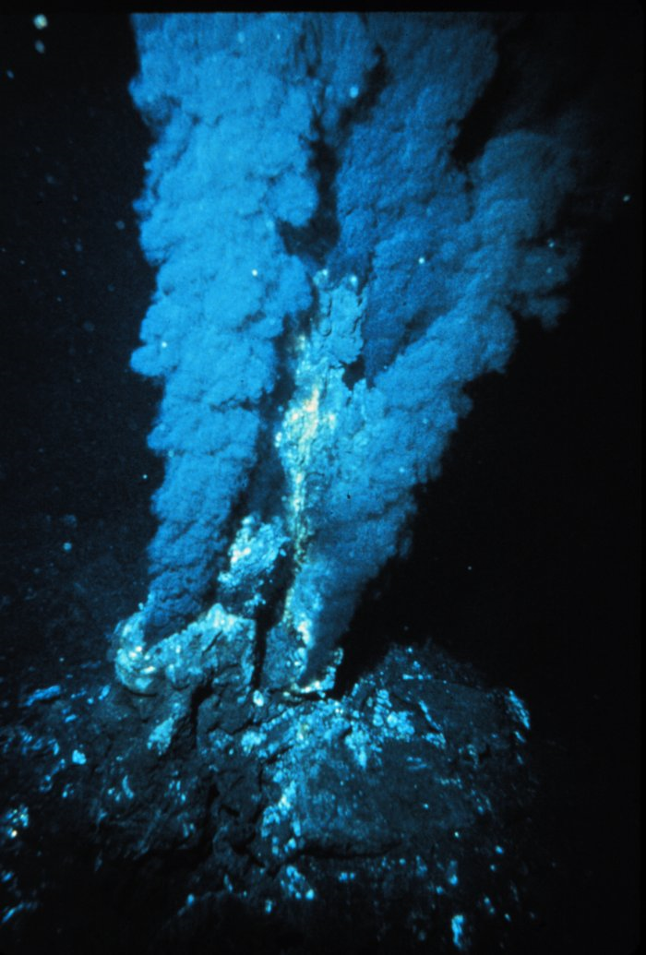
A hydrothermal vent is a fissure in a planet's surface from which exothermally heated water issues. Hydrothermal vents are commonly found near volcanically active places, areas where tectonic plates are moving apart, ocean basins, and hotspots.

Slide 14
A Sea Vent
Is a type of hydrothermal vent found on the ocean floor.
Formed in fields hundreds of meters wide when superheated water from below Earth's crust comes through the ocean floor.
This water is rich in dissolved minerals from the crust, most notably sulfides. When it comes in contact with cold ocean water, many minerals precipitate, forming a black chimney-like structure around each vent.
The metal sulfides that are deposited can become massive sulfide ore deposits in time.

Slide 15
What appears to be black smoke exiting the vent is actually a highly concentrated mineral and metal cocktail drawn from the center of the Earth itself.
When these materials hit the frigid waters of the deep sea, they precipitate out of the fluid and rain down upon the seabed below.

Slide 16
Is a type of hydrothermal vent found on the ocean floor.
Formed in fields hundreds of meters wide when superheated water from below Earth's crust comes through the ocean floor.
Is rich in dissolved minerals from the crust, most notably sulfides.
Many minerals precipitate, forming a black chimney-like structure around each vent. The metal sulfides that are deposited can become massive sulfide ore deposits in time.

Slide 17
WORKING METHOD

Slide 18
Vent as a SOURCE OF MINERAL
The materials contained in the vent fluid includes iron, gold, silver, copper, zinc, cadmium, manganese, and sulfur, along with significant amounts of methane gas mixed into the fluid.
Halides, sulphates, chromates, molybdates and tungstates are also abundant.

Slide 19
Hydrothermal Fluids
Hydrothermal fluid exits the vent system from between 330C to 380C, can have a PH of around 2.4, and is generally found at very deep locations (7000 or so feet).
To keep the metallic sulfides in the solution, you need to keep two things constant: temperature and pressure. Hydrostatic pressure at those depths is what keeps the water from turning into steam as soon as it exits the vent. Mixing with cold sea water (2-4C) is what causes precipitation.

Slide 20
Recovery
While several additional stages of purification will surely be necessary, the natural heat from the process itself provides the most important part of the energy needed for the process.
If only 50% of the total volume could be recovered, that would still provide about a billion liters, or 264,000,000 gallons of fresh water daily.

Slide 21
FIRST ATTEMPT…
The Marshall Hydrothermal Recovery System brings massive quantities of hydrothermal fluid to the surface.
Temperature is incredibly high, but it does not boil because of the intense pressures at the depths where the vents are located.
The volumes noted show about 76,000,000 liters, or 20,000,000 gallons of fluid brought to the surface every hour.
As it rises through the insulated pipe structure and the ambient pressure decreases, it will flash to steam, which can be distilled back into fresh water.

Slide 22
Technology Involved…
Uses a deceptively simple system of insulated pipes and a funnel.
No attempt to deal with the superheated hydrothermal fluid at the bottom of the ocean.
Ducting that fluid to the surface to be processed on platforms similar to those used for oil exploration and drilling.

Slide 23
FLUID INVOLVED
Fluid is trapped when it is hot and is maintained within an insulated structure, which stays hot and rise.
Moves through the pipe by a combination of vent flow velocity, convection, conduction, and flash steam pressure generated as the superheated fluid rises and the ambient pressure diminishes.
A funnel mouth at the input end would act as a venturi to increase flow velocity within the pipe.

Slide 24
A TYPICAL SET-UP FOR EXTRACTION OF DEEP-SEATED DEPOSITS

Slide 25
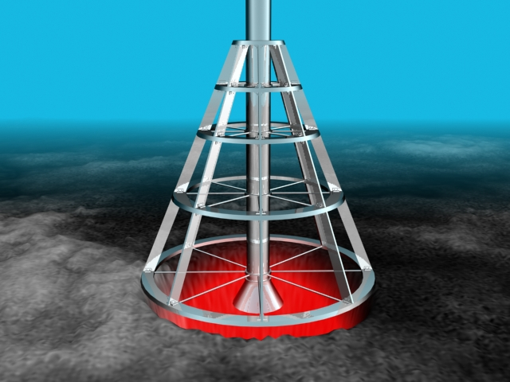

Slide 26
Base is of highly stable circles and triangles.
The first section of pipe at the top of the cone is the one that takes the weight of the column of pipe to be built above.
The intake pipe is placed as deep down into the vent as possible, to recover the highest temperature fluid. Anchors can be drilled through the bottom ring and into the seabed below for additional stability.
The funnel at the intake end is designed to act like a venturi to increase the velocity of the fluid within the pipe.
Weight was an issue.
A further source of concern was vertical stability.

Slide 27
The fluid would be utilized at the surface by providing the heat for traditional steam turbine generation.
The superheated fluid would either be used directly or it could heat a clean working fluid within a heat exchanger to ultimately drive the turbines.
On the Juan de Fuca Ridge for example, which lies about 200 miles off the coast of Seattle, the main active vent field is about 180 m wide and 350 m long.

Slide 28
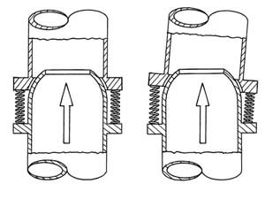
STABILITY OF THE RIG
Buoyancy collars were added to the design.
The vertical stability would be greatly enhanced.
Adding in swiveling connections between the pipe segments to allow flexibility and using intermittent mooring lines to stabilize the column were the finishing touches.

Slide 29
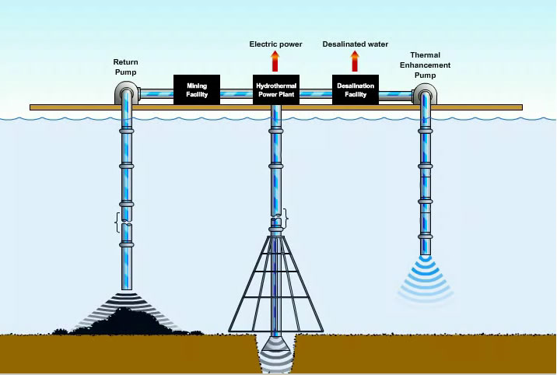
The complete Hydrothermal Recovery System, showing electric generation, water desalination, and mining facilities operating together.

Slide 30
Extracting metals directly from hydrothermal fluids
The idea is to pump the fluid directly into some kind of metal extraction process before the sulfides can precipitate.

Slide 31
CASE STUDIES
In 2005, Neptune Resources , was granted 35,000 km² of exploration rights over the Kermadec Arc in New Zealand's Exclusive Economic Zone to explore for seafloor massive sulfide deposits, a potential new source of lead-zinc-copper sulfides formed from modern hydrothermal vent fields.
An April 2007 exploration of the deep-sea vents off the coast of Fiji found those vents to be a significant source of dissolved iron.

Slide 32
PROS AND CONS

Slide 33
PROBLEMS ASSOCIATED…
Very high temp. of the fluid.
Keeping the minerals in solution while pumping it through pipes.
If any minerals precipitate in the pipes, it'll plug up the whole system.

Slide 34
REMEDIES…
Pumping solutions with precipitates doesn't sound very good - why not filter off the solids?
Alternatively, could we just pump large amounts of acid down and dissolve the metals.

Slide 35
TO SUM UP…
Lot of good metals are dissolved in hydrothermal vent fluids.
Metals come out of solution when the water cools.
They precipitate out. They fall on the ocean floor.
Just go down to the sites of dead smokers (where all the life has died off) and scrape up the ocean floor by some dredging arrangement!

Slide 36
Set up structures near the smokers composed of metals .
Desired substance would tend to precipitate out on it or react with it. You could haul these things to the surface like a lobster trap, scrape off all the thorium or whatever, the drop it back down to pick up another load.
Some geothermal power plants have the problem that they wash a lot of toxic metal compounds to the surface. If you combine metal recovery with geothermal power generation you may reach break even earlier.

Slide 37
OTHER CONCERNS…
At some depth (unknown at this time), hydrostatic pressure would be insufficient to keep the hot fluid in a liquid state. Beneath this point, a pump of some kind would need to be installed to keep the fluid above it higher than the threashold pressure. Pressure problem solved.
At one point, it is considered depleated uranium as a possible material to line the inside of the pipe with. Unfortunatly, there are a host of environmental and corrosion concerns with using this material.
The technology for using titanium in this kind of application already exists but hasn't been used in this application. Corrosion problem likely solved.

Slide 38
Ecological Concerns…
There is always a concern about the environmental consequences that its implementation might produce.
Hydrothermal vents are home to an amazing variety of organisms and animals that are found nowhere else on Earth.

Slide 39
ADVANTAGES
Driven by the elevated price activity in the base metals sector.
Extraction of mineral resources from hydrothermal fields on the seafloor.
Significant cost reductions are(in theory) possible.
Is a continuous process.
Automation possible.

Slide 40
DEMERITS
High initial Capital requirement.
Adverse effects on marine organisms evident.
Dependence on oceanic currents.
Less know-how known.

Slide 41
PRESENT FACILITIES ROUND THE GLOBE
Nautilus Minerals :
Advanced stages of commencing extraction from its Solwarra deposit, in the Bismarck Archipelago
Neptune Minerals is at an earlier stage with its Rumble II West deposit, located on the Kermadec Arc, near the Kermadec Islands.
Nautilus Minerals, in partnership with Placer Dome (now part of Barrick Gold), succeeded in 2006 in returning over 10 tones of mined SMS to the surface using modified drum cutters mounted on an ROV - a world first.

